Slide 1
Generative AI for Economic Research: Use Cases and Implications for Economists
Author: Anton Korinek
Presenter: Adeline(Haining)Yuan
How often do you use ChatGPT daily?

Slide 2
Introduction:
Rapid advances in generative artificial intelligence (AI)—especially large language models (LLMs) have transformed how economists can perform research tasks.
The past few years have seen unprecedented advances in generative AI, especially large language models (LLMs) such as ChatGPT, Claude, and Bard. These systems can generate, interpret, and critique text, code, and data with increasing fluency. (Now also have Deepseek!)

Slide 3
Motivation & Scope
The article serves as a comprehensive guide to practical AI applications for economists. It systematically classifies dozens of concrete use cases into six major domains:
Ideation and Feedback – brainstorming, refining research questions, identifying limitations.
Writing – drafting, summarizing, editing, and improving style and clarity.
Background Research – summarizing literature, translating, and formatting references.
Coding – generating, debugging, or translating code across languages (Python, R, MATLAB).
Data Analysis – extracting and transforming data, classifying text, and creating figures.
Mathematical Derivations – explaining or setting up models, checking algebraic steps.
Each task is evaluated according to usefulness, rated as ○ experimental, ◐ useful with oversight, or ● highly useful.

Slide 4
Approach:
The article is written as a hands-on demonstration. Korinek uses live prompts and examples—many generated directly through ChatGPT and Claude to illustrate capabilities and common pitfalls.
It includes a concise technical primer explaining how LLMs are trained, what reinforcement learning from human feedback (RLHF) is, and why data cutoffs (the latest date of the model’s training information) limit their knowledge of recent events.
The discussion balances optimism and caution: while LLMs can dramatically increase research productivity, they also introduce issues of bias, hallucination, reproducibility, and data privacy.

Slide 5
Main Argument:
Generative AI represents a new “general-purpose cognitive technology.” Like the spreadsheet or the search engine, it can transform how economists think, write, and model.
However, the paper emphasizes that AI should augment, not replace, the economist’s role. Economists remain essential for formulating research questions, interpreting results, and exercising judgment.
In the medium term, AI will likely become a co-pilot or tutor for researchers; in the long term, it may become capable of autonomous scientific discovery, raising profound questions about intellectual credit, creativity, and academic evaluation.

Slide 6
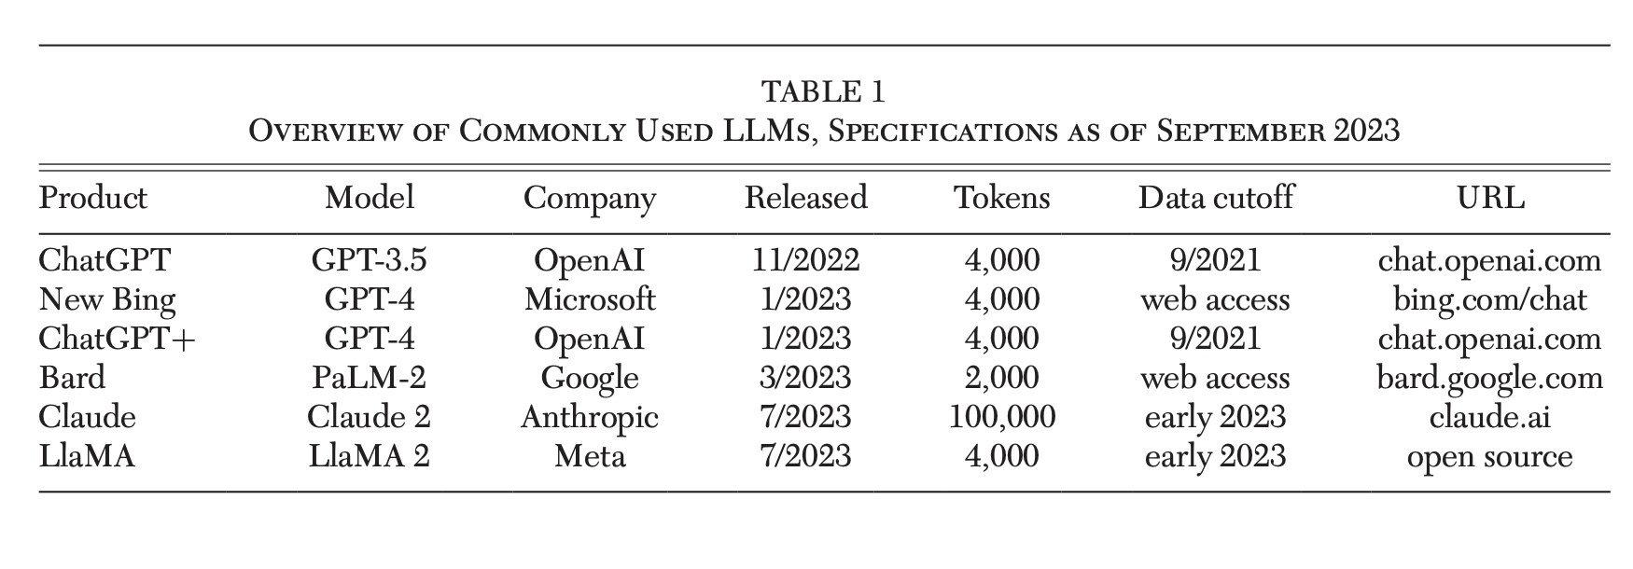
Results:
A quick snapshot of the main generative AI tools they might use for research and how they differ in scope and recency.
The table highlights two main contrasts:
Context length differences (from 2 k to 100 k tokens) → affects how long a text or dataset the model can handle.
Knowledge recency → some models (ChatGPT 3.5/4) stop at 2021, while others (Bing, Bard) access the web or have 2023 data.

Slide 7
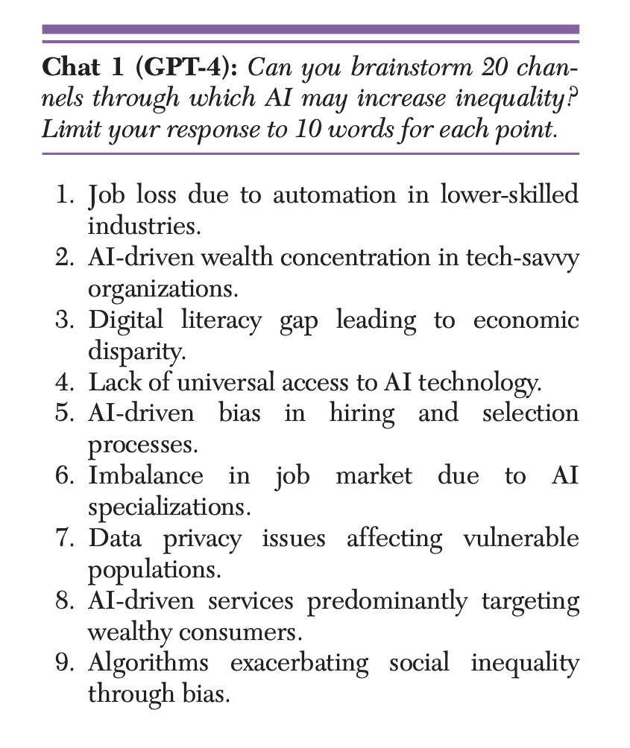
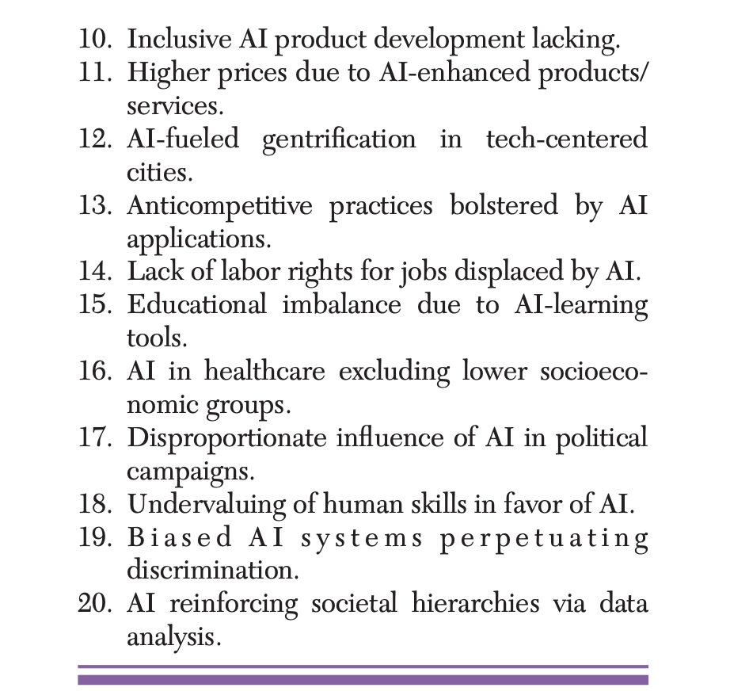
Following:
The following prompt illustrates a simple example using GPT-4. Throughout the remainder of this section, The article present all examples generated by LLMs as indented text.
However, Korinek cautions that such models lack economic reasoning, prioritization, or evidence—they supply breadth, not depth. The output should be treated as a first draft of ideas, to be critically refined by the human economist using domain knowledge.

Slide 8
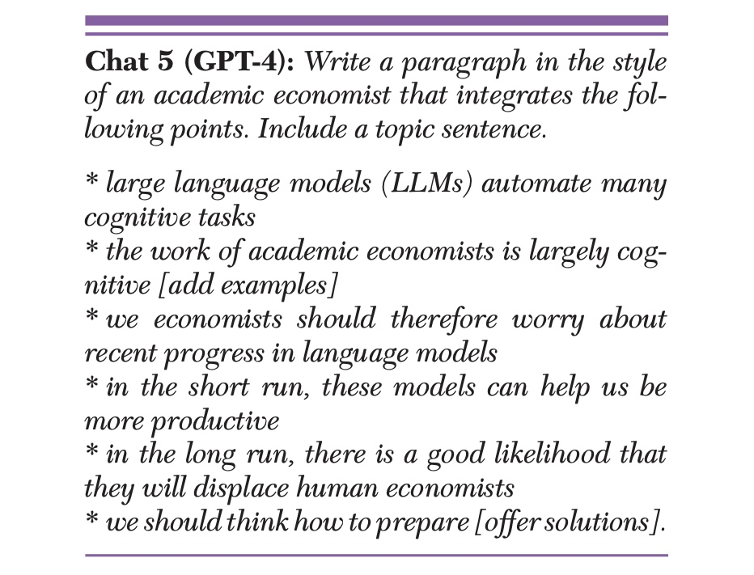
As a writing tool: synthesize basic text
LLMs can already produce polished academic prose reflecting complex economic reasoning.
Korinek concludes that while these systems currently serve as assistants that amplify productivity,
The rapid progress means economists must anticipate structural change in their own profession—by learning, adapting, and guiding the responsible integration of AI into research and society.

Slide 9
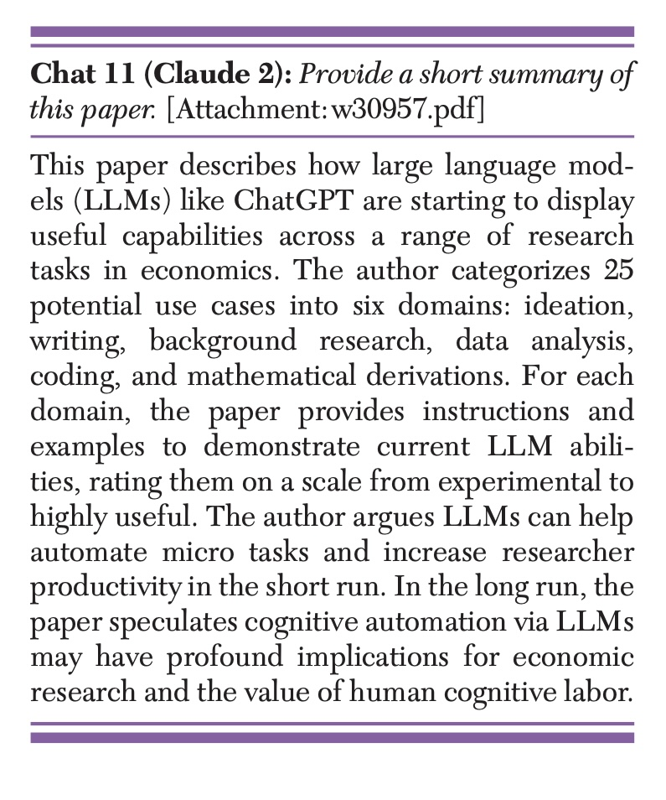
As a background research tool :
the LLM Claude 2 can process texts with up to 100,000 tokens or about 75,000 words at the time of writing, which covers the length of almost all academic papers as well as many books.
GPT-3.5/GPT-4 can process only up to 4,000 tokens or about 3,000 words, limiting the ability to produce summaries of longer texts.

Slide 10
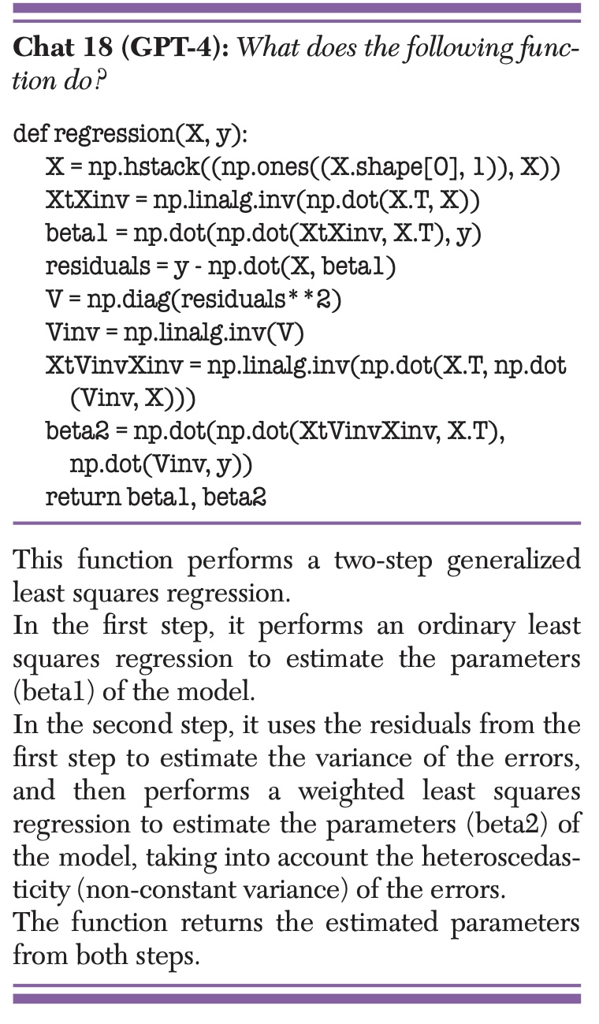
As a coding tutor:
LLMs can write, edit, modify, translate or debug snippets of code based on instructions in plain English (or other natural languages).
Moreover, they can act as tutors when using new libraries, functions, or even programming languages that the user is not very familiar with by quickly generating output that shows what libraries and functions are needed for specific types of operations.

Slide 11
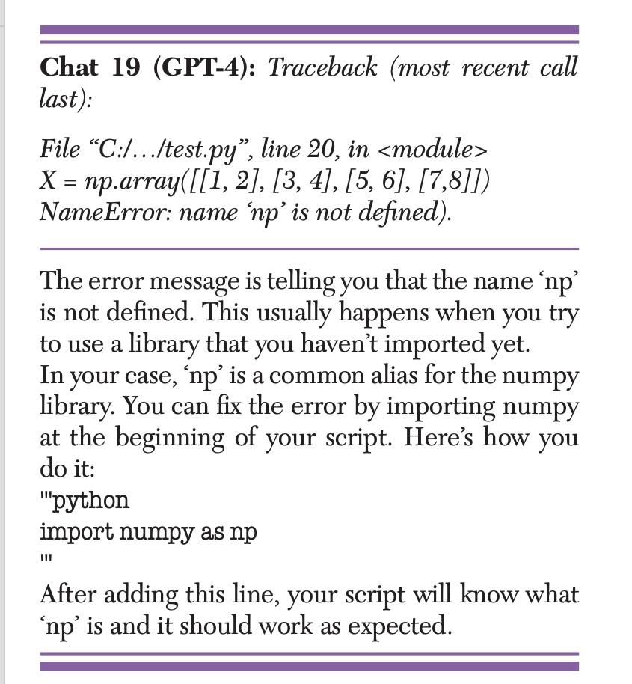
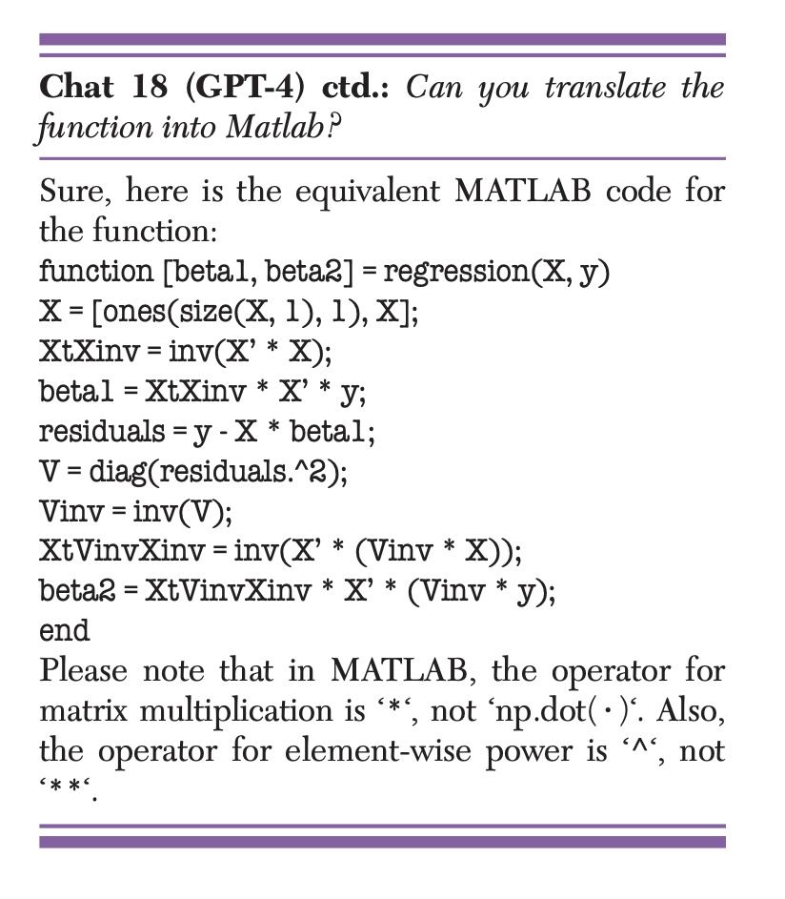
Translate and debugging code:
However, they are less ­capable at detecting high-level mistakes in the algorithms underlying code—for this,
human debugging is usually still required.

Slide 12
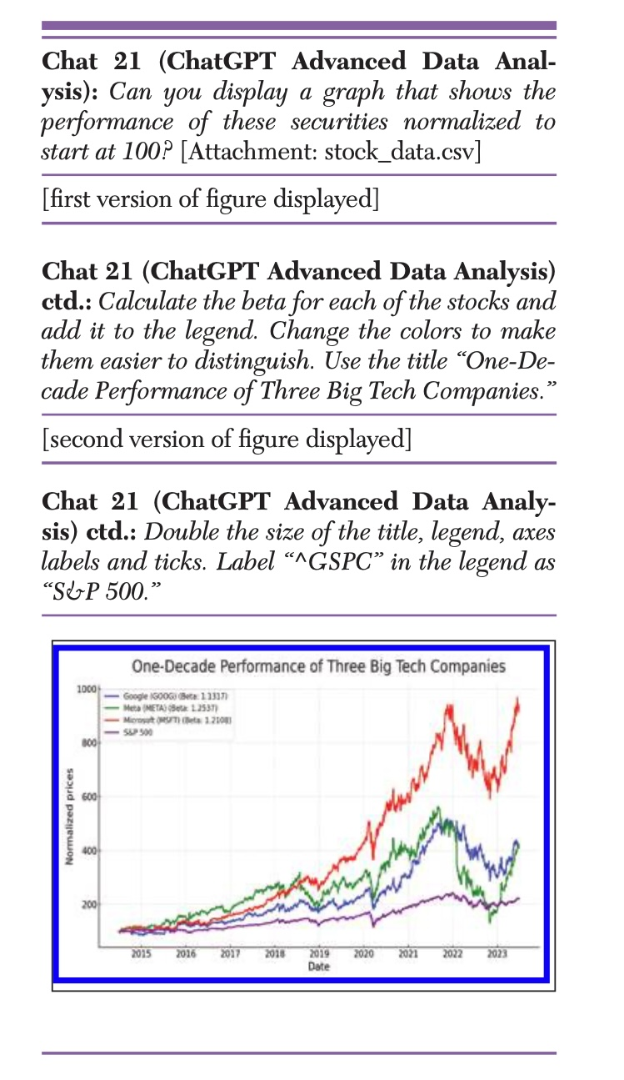
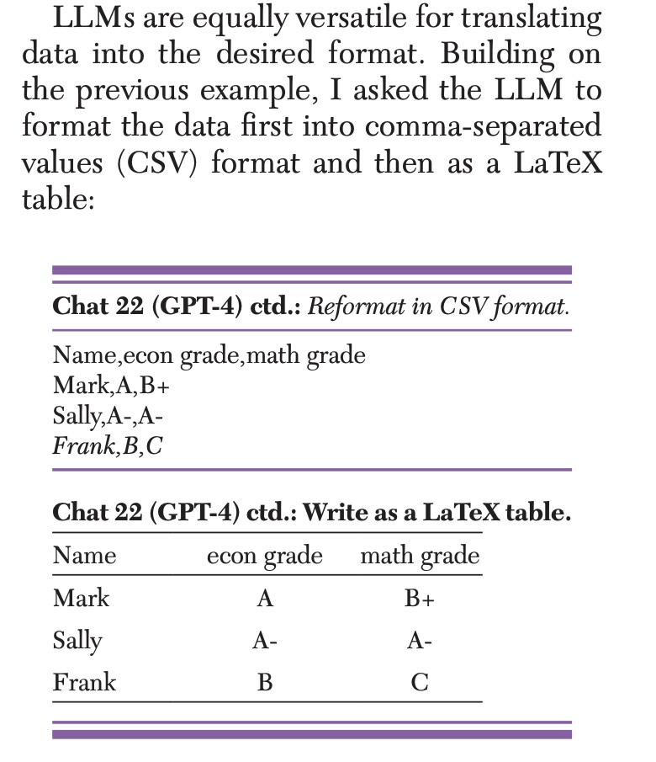
As data analysis tool:

Slide 13
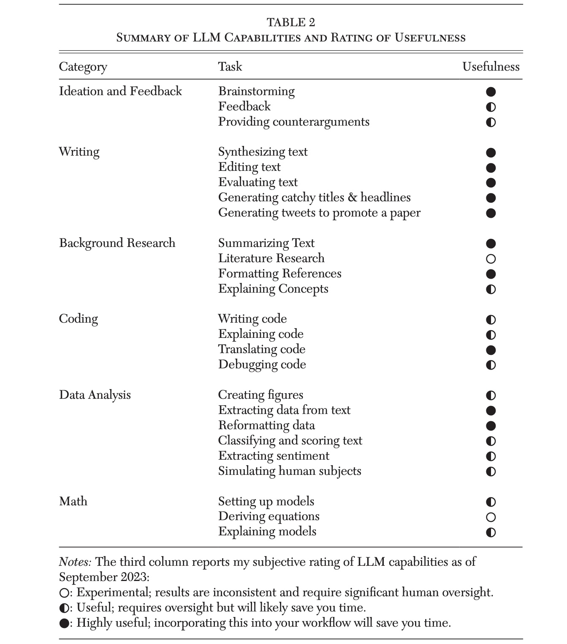
Useful VS Not Useful
The author finds that writing-related tasks—such as synthesizing text, editing, evaluating, creating titles, and generating tweets—are rated highly useful).
Similarly, brainstorming and idea generation are also highly effective.
Translating code and reformatting data receive highly useful rating:indicating strong reliability for technical assistance.
But writing code, explaining code, debugging, and creating figures are ◐ (useful with oversight).

Slide 14
Conclusion:
Generative AI marks a new era in economic research: Large language models (LLMs) like ChatGPT can now perform many cognitive micro-tasks—drafting, editing, coding, summarizing—that dramatically boost productivity.
Writing and ideation tasks are already highly reliable. As shown in Table 2, LLMs are most effective for writing, summarizing, and creative brainstorming, while more technical tasks still require human check.
Human expertise remains essential. Economists must verify outputs, watch for hallucinations and bias, and understand data cutoffs and other model limits. Again, LLMs should serve as co-pilots, not replacements.
AI will reshape how economists work. In the near term, these tools will become routine assistants for research, teaching, and communication. In the longer run, they may transform knowledge creation and the economics profession itself.

Slide 15
“Use generative AI thoughtfully—embrace its potential to enhance creativity and efficiency, but pair it with critical judgment, transparency, and ethical responsibility.”
-------Anton Korinek

